Slide 1
Class 5 – Javascript & Jquery

Slide 2
Why JavaScript?
JavaScript is one of the 3 languages all web developers must learn
HTML to define the content of web pages
CSS to specify the layout of web pages
JavaScript to program the behavior of web pages
(Reminder: JavaScript ≠ Java!)

Slide 3
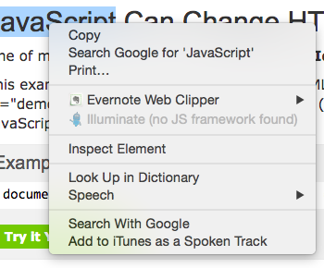
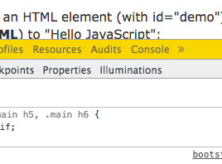
JavaScript – Interactive
Try it in Chrome's JavsScript console. Right-click (on a Mac, Control-click) and choose "Inspect Element." Then choose "Console" from the menu bar.
Try these:
console.log('hello, there');
window.alert('How are you?');
document.writeln('Where does this go?');
document.write('<h1>JavaScript</h1>');
document.write('<div id="bear">Baby</div>');
document.getElementById("bear").innerHTML = "Cub";
document.getElementById("bear").style .backgroundColor='yellow';

Slide 4
JavaScript Inline
<script>
console.log('hello, there');
window.alert('How are you?');
document.writeln('Where does this go?');
document.write('<h1>JavaScript</h1>');
document.write('<div id="bear">Baby</div>');
document.getElementById("bear").innerHTML = "Cub";
document.getElementById("bear").style .backgroundColor='yellow';
</script>

Slide 5
JavaScript Functions
example-02.html:
function why(predator, prey) {
document.writeln('<p>She swallowed the ' + predator);
document.writeln(' to catch the ' + prey);
document.writeln('</p>');
}
why("cow","goat");
why("goat","dog");
why("dog","cat");
why("cat","bird");
why("bird","spider");
why("spider","fly");

Slide 6
JavaScript Files
<script src="example-03.js"></script>
example-03.js:
function beerverse (bottleCount){
while (bottleCount > 0) {
var verse = bottleCount + " bottles of beer on the wall<br>"
+ bottleCount + " bottles of beer!<br>"
+ "Take one down, pass it around<br>"
+ --bottleCount + " bottles of beer on the wall!";
console.log('bottlecount: ' + bottleCount);
document.writeln('<p>' + verse + '</p>');
}
}

Slide 7
Interactive JavaScript
<h1>Interactive JavaScript</h1>
<p id="demo">JavaScript can change HTML content.</p>
<button type="button"
onclick="document.getElementById('demo').innerHTML = 'Hello!'"
>Click Me!</button>

Slide 8
Javascript Resources
Cheatsheets:
Overapi: http://overapi.com/javascript/
Dave Child: http://www.cheatography.com/davechild/cheat-sheets/javascript/
Dustin Allen: https://superiorprogrammer.files.wordpress.com/2013/01/javascript-cheat-sheet.jpg
http://www.cheat-sheets.org/saved-copy/jsquick.pdf
Static references:
Addison Wesley: http://wps.aw.com/wps/media/objects/2234/2287950/javascript_refererence.pdf
http://www.javascript.su/
Interactive:
w3schools: http://www.w3schools.com/js/
http://www.codecademy.com/en/tracks/javascript
https://www.codeschool.com/paths/javascript
Sharing:
jsfiddle.net
stackoverflow.com/questions/tagged/javascript

Slide 9
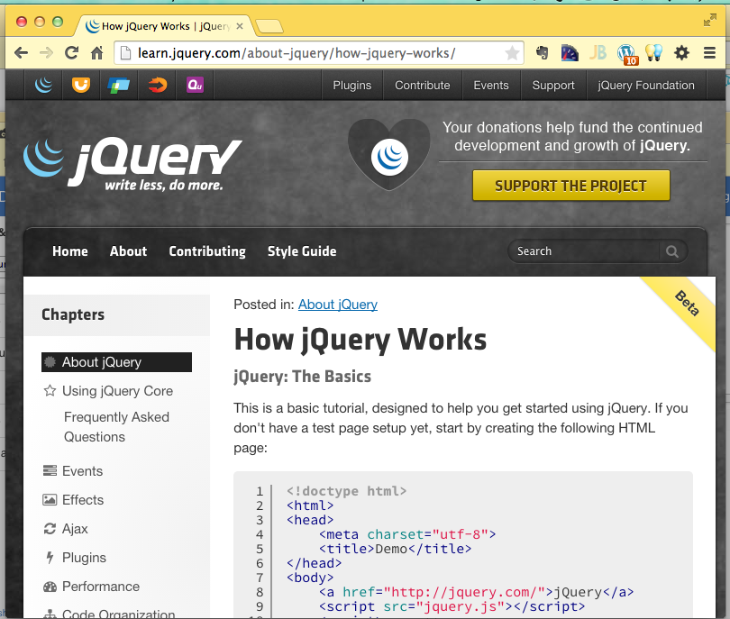
Jquery
Easier JavaScript
Cross-platform compatability - made JavaScript practical!
Inspired other frameworks, whole new world of “web applications”
http://jquery.com/

Slide 10
Load jQuery from Google
<script src="http://ajax.googleapis.com /ajax/libs/jquery/1.11.2/jquery.min.js"> </script>

Slide 11
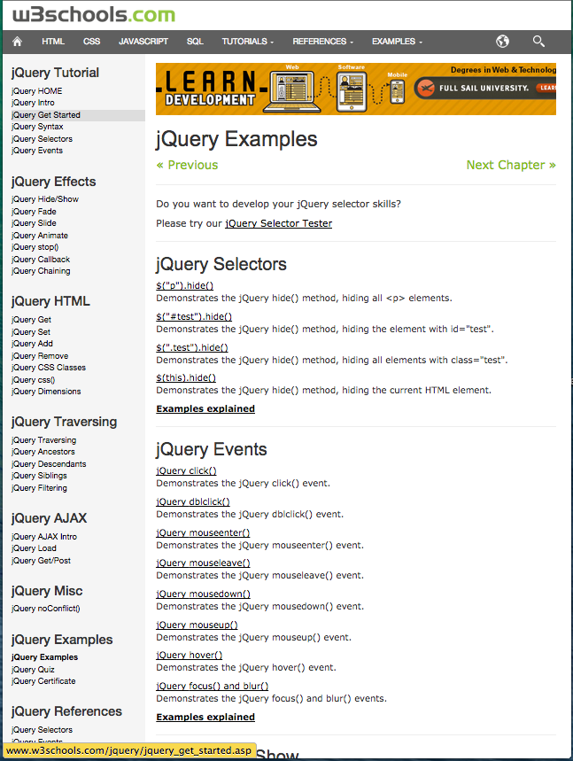
List of Examples
http://www.w3schools.com
/jquery/jquery_examples.asp

Slide 12
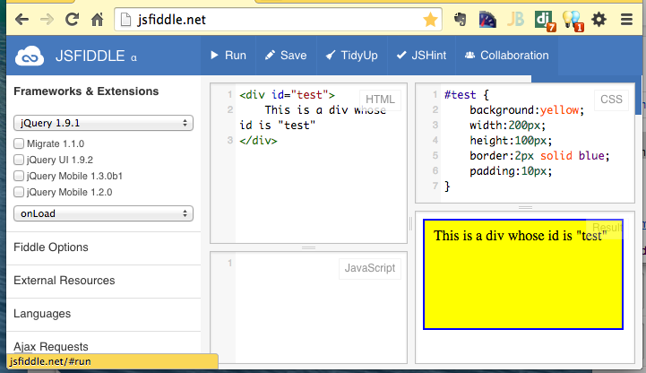
JS Fiddle
Online editor/demo environment
Automatically creates shortcut URL
http://jsfiddle.net/afe8xyof/1/

Slide 13
Move (animate) a DIV
http://www.w3schools.com/jquery/tryit.asp?filename=tryjquery_animation1 (http://is.gd/basweb_jq01)
$(document).ready(function(){
$("button").click(function(){
$("div").animate({left: '250px'});
});
});
http://jsfiddle.net/rze9g623/

Slide 14
Hide and show
http://www.w3schools.com/jquery/tryit.asp?filename=tryjquery_hide_show (http://is.gd/basweb_jq02)
$(document).ready(function(){
$("#hide").click(function(){
$("p").hide();
});
$("#show").click(function(){
$("p").show();
});
});
<button id="hide">Hide</button>
<button id="show">Show</button>
http://jsfiddle.net/f6qn0g2n/1/

Slide 15
Fade
http://www.w3schools.com/jquery/tryit.asp?filename=tryjquery_fadetoggle (http://is.gd/basweb_jq03)
$(document).ready(function(){
$("button").click(function(){
$("#div1").fadeToggle();
$("#div2").fadeToggle("slow");
$("#div3").fadeToggle(3000);
});
});
http://jsfiddle.net/zyn61v79/1/

Slide 16
Slide
http://www.w3schools.com/jquery/tryit.asp?filename=tryjquery_slide_toggle (http://is.gd/basweb_jq04)
$(document).ready(function(){
$("#flip").click(function(){
$("#panel").slideToggle("slow");
});
});
http://jsfiddle.net/yxoq9v3a/

Slide 17
Animate
http://www.w3schools.com/jquery/tryit.asp?filename=tryjquery_animation (http://is.gd/basweb_jq05)
$(document).ready(function(){
$("button").click(function(){
var div=$("div");
div.animate({height: '300px', opacity: '0.4'}, "slow");
div.animate({width: '300px', opacity: '0.8'}, "slow");
div.animate({height: '100px', opacity: '0.4'}, "slow");
div.animate({width: '100px', opacity: '0.8'}, "slow");
});
});
http://jsfiddle.net/mboja5yo/
http://jsfiddle.net/930b9b3j/

Slide 18
Chain
http://www.w3schools.com/jquery/tryit.asp?filename=tryjquery_chaining (http://is.gd/basweb_jq06)
$(document).ready(function(){
$("button").click(function(){
$("#p1").css("color", "red").slideUp(2000).slideDown(2000);
});
});
http://jsfiddle.net/bguxpzsh/

Slide 19
More on Jquery
W3Schools
http://www.w3schools.com/jquery/jquery_examples.asp
Code Academy
http://www.codecademy.com/en/tracks/jquery
Code School
https://www.codeschool.com/courses/try-jquery

